Slide 1
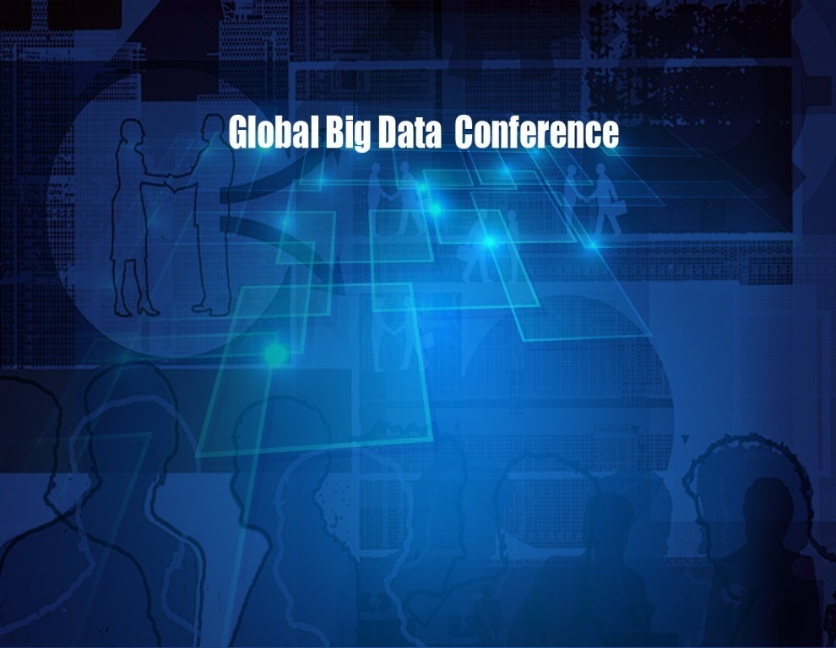
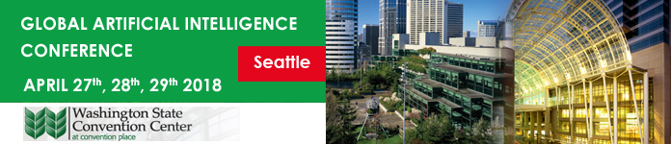
www.globalbigdataconference.com
Twitter : @bigdataconf
#GAIC

Slide 2
Developing and deploying NLP services on the cloud using Azure ML and the Team Data Science Process Sentiment Classification & Entity Recognition
2
Debraj GuhaThakurta
Cloud & AI
Algorithms and Data Science Group
Global Artificial Intelligence Conference April 28, 2018, Santa Clara, CA
https://aka.ms/tdsp-presentations
Deck available @: https://aka.ms/tdsp-presentations
Credits: Mohamed Abdel-Hady, Wei Guo, Raza Khan, Akshay Mehra, Zoran Dzunic

Slide 3
Agenda
3
Team Data Science Process (TDSP)
Principle and objective
Key components
Adoption and use
Azure Machine Learning (AML)
Key features
Developing and deploying AI solutions
Using AML and TDSP to develop & deploy NLP services

Slide 4
Team Data Science Process (TDSP) Agile and iterative process to develop, deploy and manage AI applications on the cloud
4
Process
Tools (algos, IDEs, workbench)
Platform (compute, storage, ...)
https://aka.ms/tdsp
tdsp-feedback@microsoft.com

Slide 5
Process challenge in Data Science
5
Global Teams
Organization
Collaboration
Quality
Knowledge Accumulation
Agility
Geographic Locations
Team Growth
“Intelligent” application (ML/AI) development has unique complexity not always encountered in other Software Development scenarios
Onboard New Members Rapidly
Varied Use Cases
Industries and Use Cases
Diverse DS Backgrounds
DS have diverse backgrounds, experiences with tools, languages

Slide 6
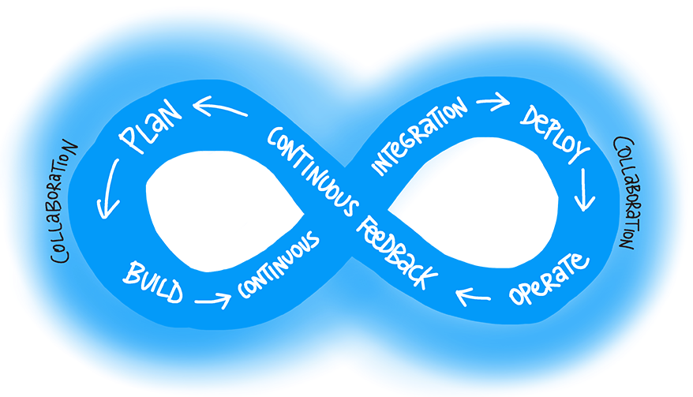
Data Science can borrow processes from DevOps
6
Integrated Software Development & Operations (DevOps) has had much more time to mature, standardize, build in efficiency and develop best practices
Data Science has unique complexity – but can learn standardized processes from DevOps

Slide 7
TDSP objective
7
Integrate DevOps with data science workflows to improve collaboration, quality, robustness and efficiency in data science projects
DevOps
+
Data Science
=
TDSP
Infrastructure as Code (IaC)
Build
Test
CI / CD
Release management
Performance monitoring
Data ingestion
Data exploration
Modeling (experimentation)
Model deployment & consumption
Agile

Slide 8
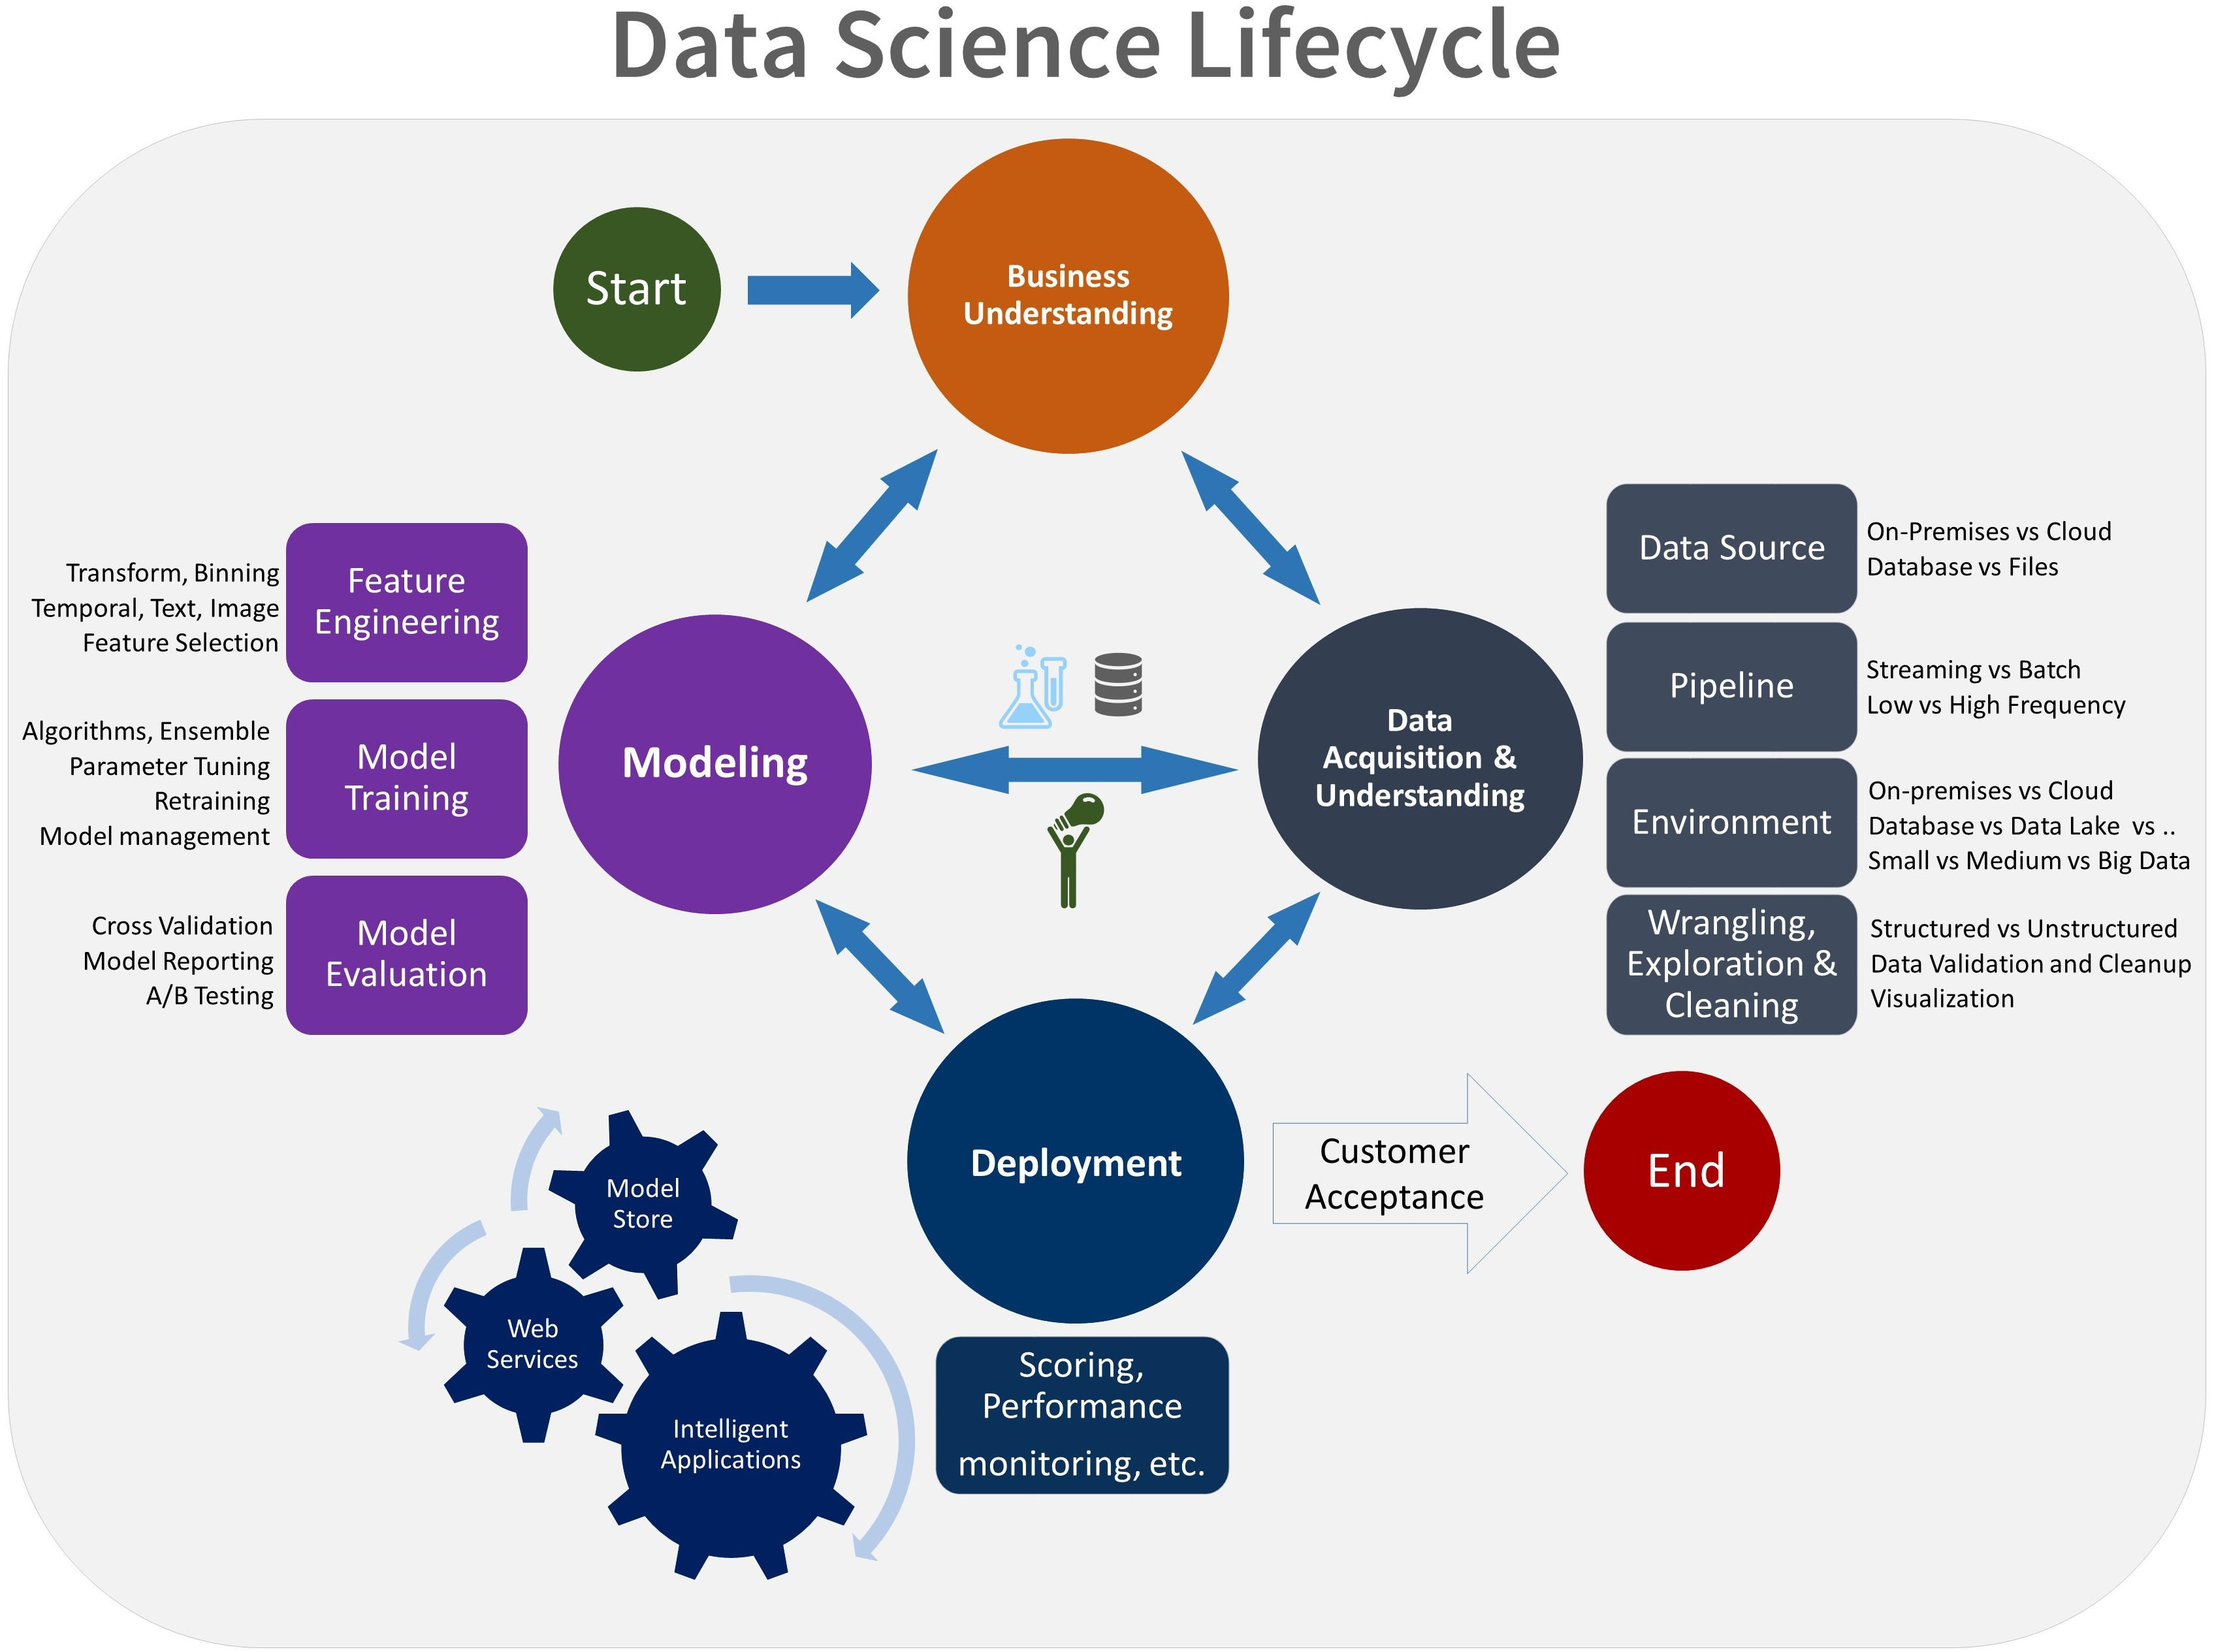
Data Science lifecycle
8
Primary stages:
Business Understanding
Data Acquisition and Understanding
Modeling
Deployment

Slide 9
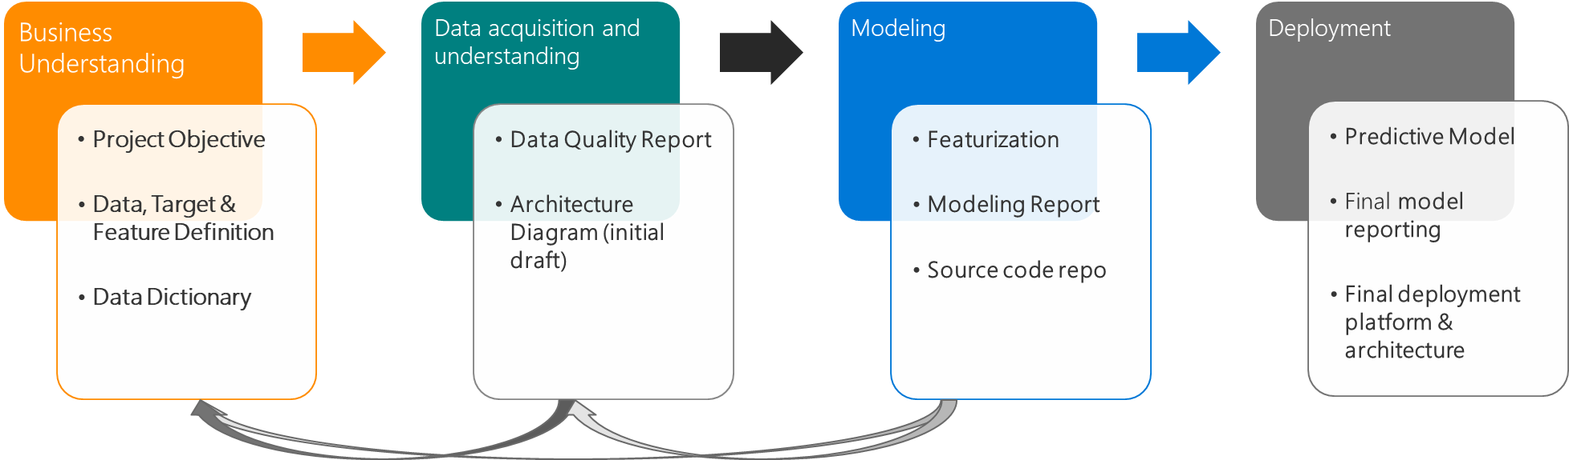
TDSP lifecycle stages can be integrated with specific deliverables & checkpoints – Templates available
9

Slide 10
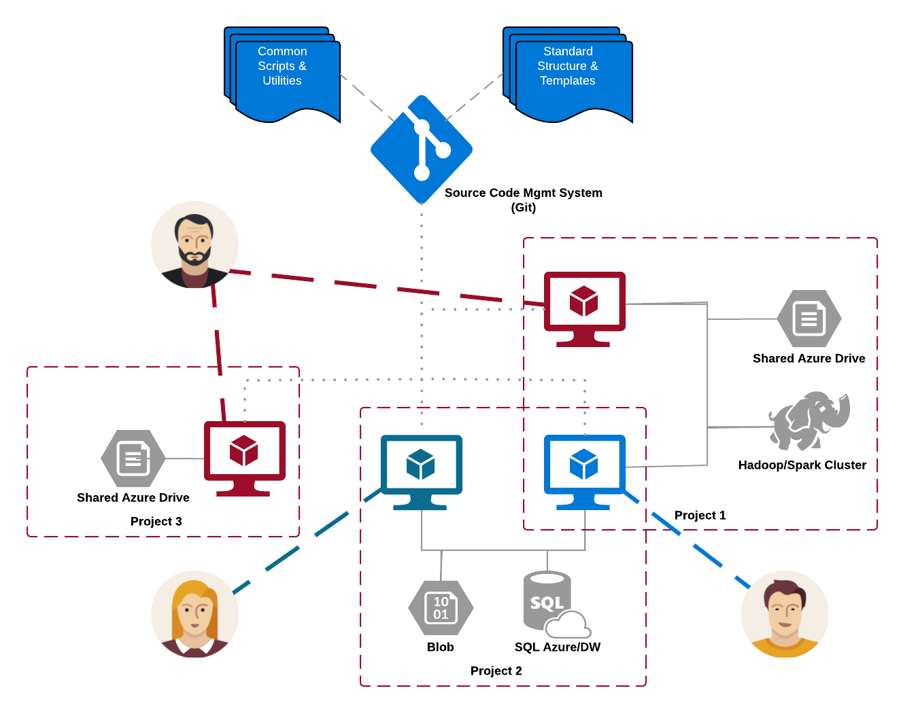
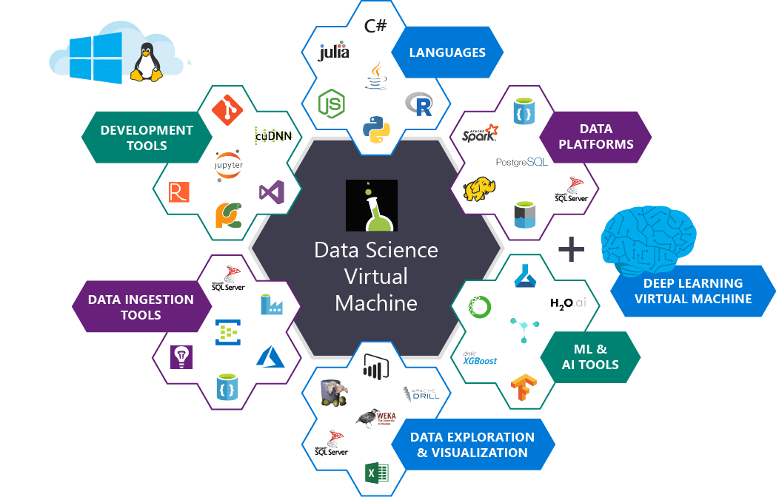
Shared and distributed infrastructure & toolkits
10
Project artifacts & code stored in central git (version control) repositories.
Data typically stored in cloud stores, such as blob or database
Virtual machines (VMs), or clusters are disposable compute, added to projects as needed
Many-to-many relationship between data scientists, compute and projects

Slide 11
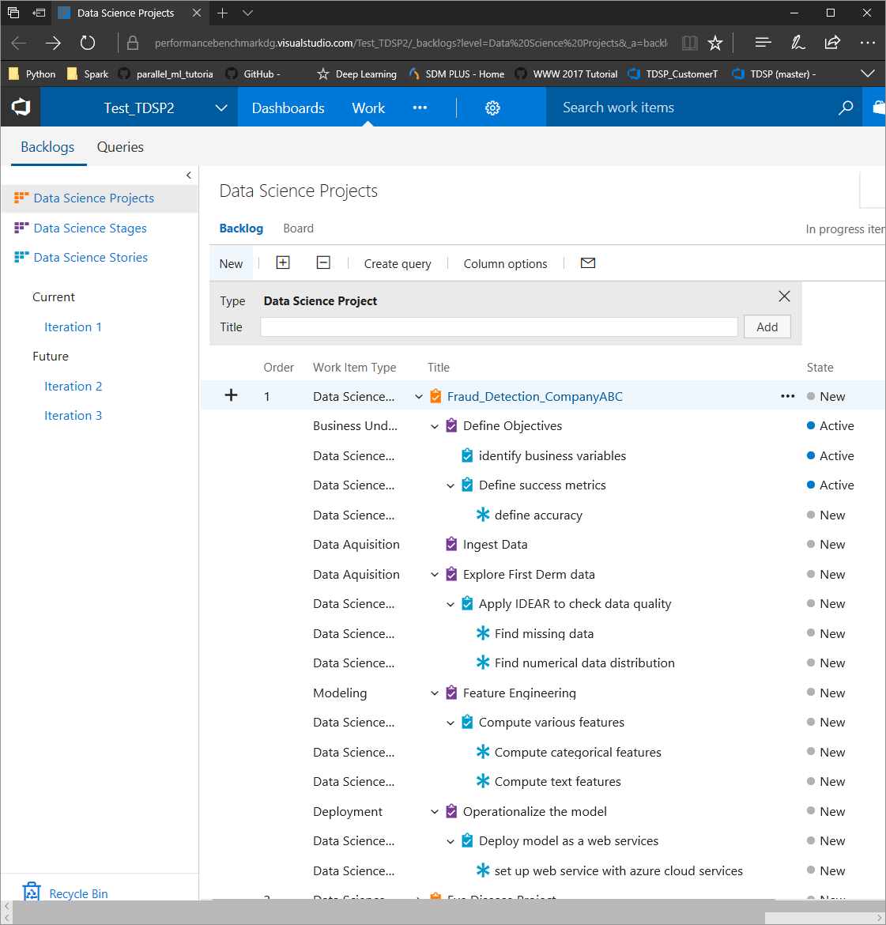
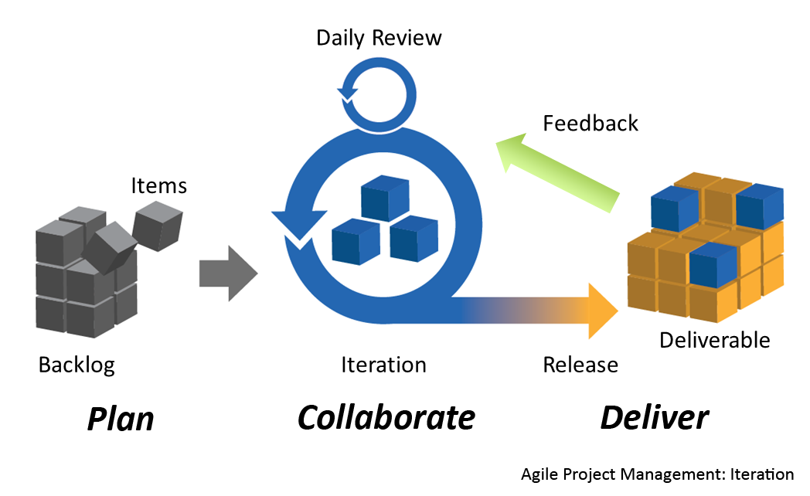

Agile work planning and execution template
11
Use Agile work planning & execution template (data science specific)
DS Projects: e.g. “Fraud Detection for Customer ABC”
DS Stages: correspond to the stages in TDSP lifecycle.
DS Stories: correspond to the life-cycle sub-stages.
DS Tasks: Tasks are assignable code or document work items to complete a specific data science story.
Scrum
framework
https://commons.wikimedia.org

Slide 12
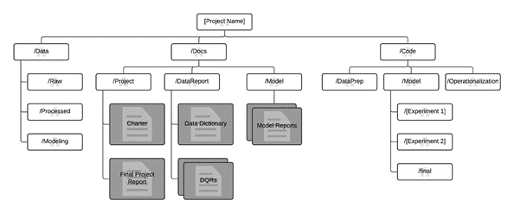

Collaborative development guidelines
12
Version control and review
Git is a Version Control System
Each repo contains the full change history
Used in a distributed way with a single remote repo and several local repos (on local machine or a VM)
TDSP git Template
Remote
Integrated Agile planning & code development
Local
Local
Local
Local

Slide 13
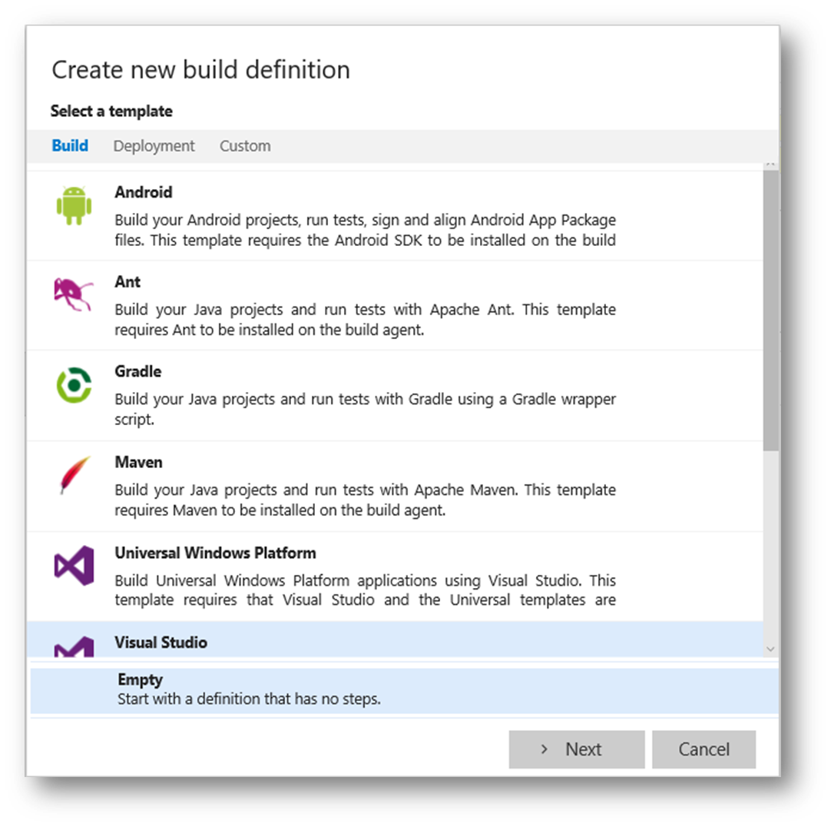
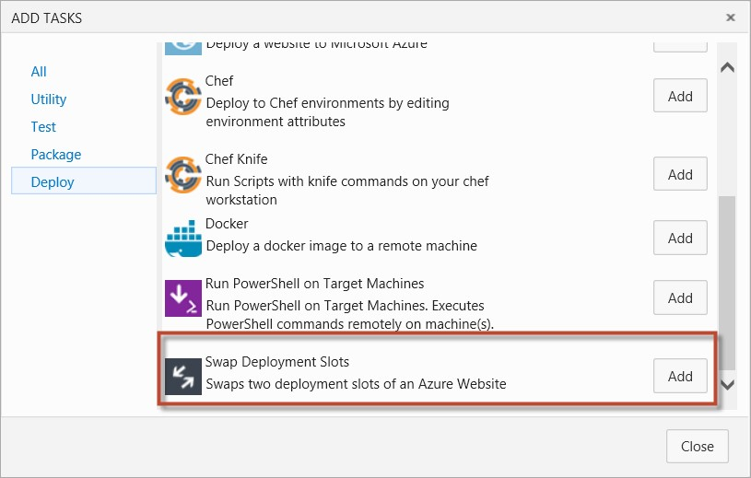
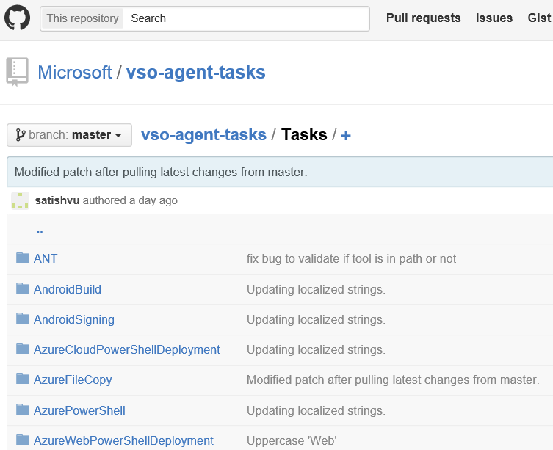
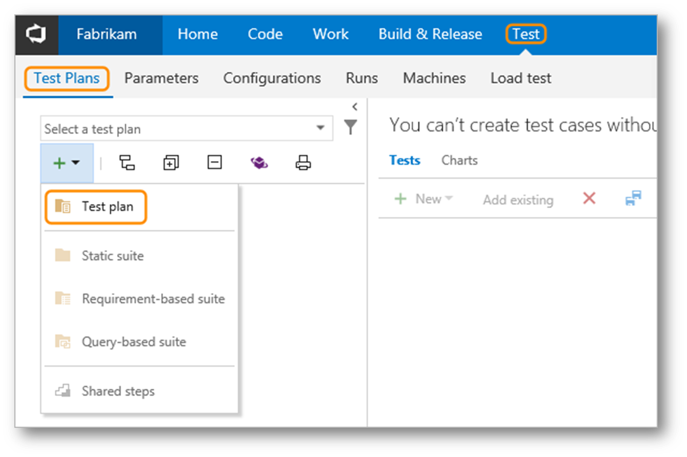
Custom Build Tasks
13
Integrating DevOps in projects
Notes:
Understanding TFS/VSO builds - https://msdn.microsoft.com/en-us/library/ms181709(v=vs.90).aspx

Slide 14
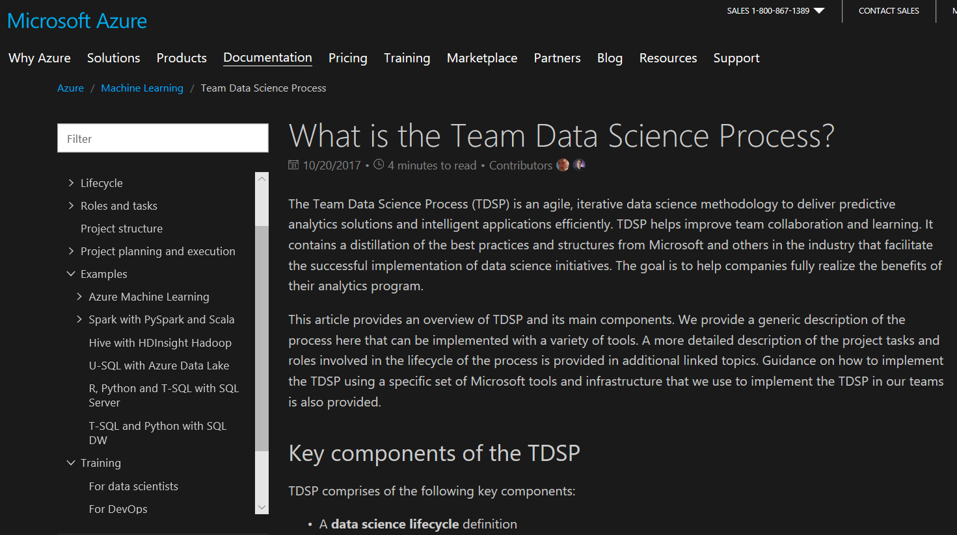
TDSP documentation: https://aka.ms/tdsp
14

Slide 15
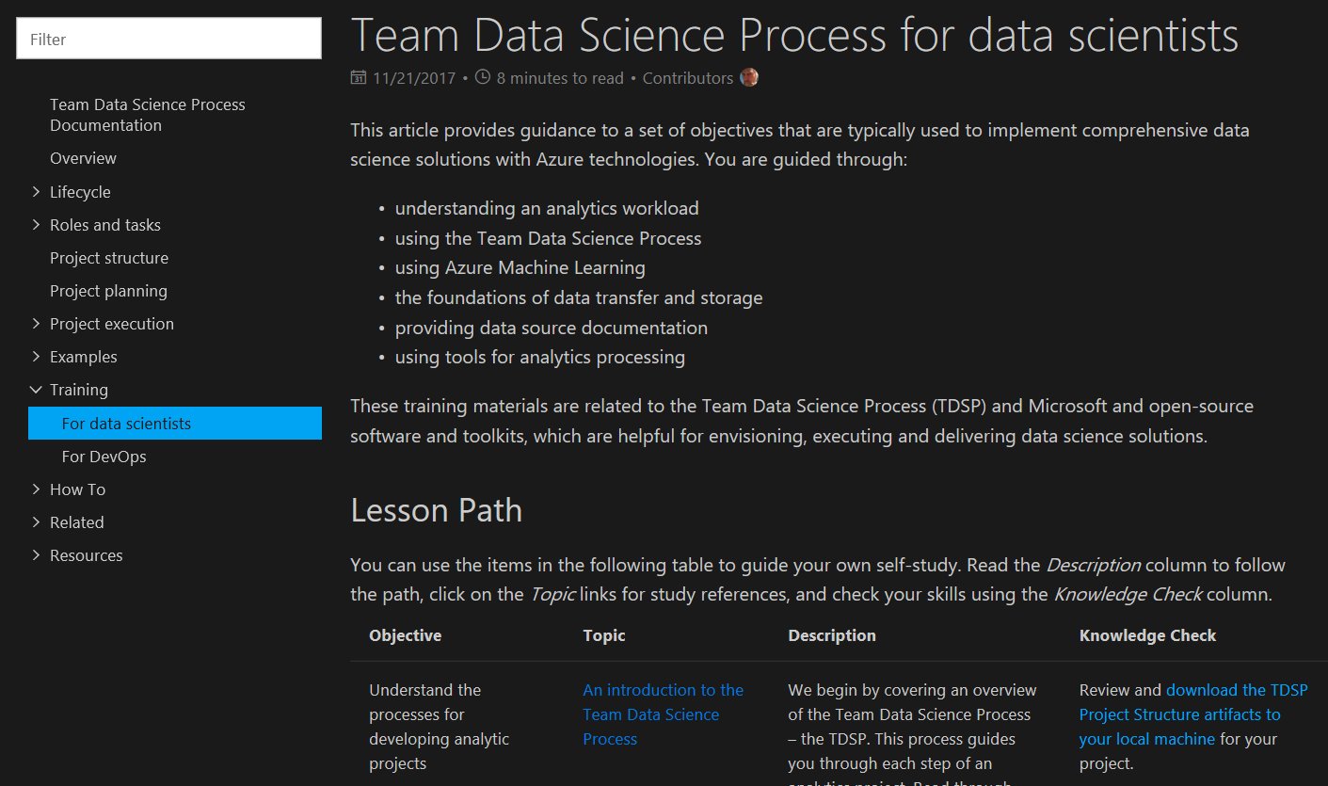
TDSP trainings
15

Slide 16
Azure Machine Learning
16
https://docs.microsoft.com/en-us/azure/machine-learning/service/

Slide 17
17
Azure Machine Learning
LOB
CRM
INGEST
STORE
PREP & TRAIN
MODEL & SERVE
Graph
On-prem
Cloud
Image
Data orchestration and monitoring
Data lake and storage
Hadoop/Spark/SQL and ML
Social
IoT
Apps + insights
IoT
Cloud
Azure Machine Learning

Slide 18
Deploy everywhere
18
Single node deployment (cloud/on-prem)
Azure Container Service
Azure IoT Edge
DOCKER
Spark clusters
Notes:
Docker container based deployment allows:
Single node deployment (cloud/on prem)
Clustered deployments via Azure Container Service
public preview target of 10k RPS on ACS cluster configuration
Currently have published models (via TLC) with <10ms latency
Edge deployment via Azure IOT Edge
Microsoft ML Server on-premises
Other deployment options
Spark clusters
Data engines:
SQL
CosmosDB (roadmap)
U-SQL (roadmap)
FPGAs (roadmap)
Serverless (roadmap)
Docker logo
Single node (on prem, cloud
ACS
Edge
MSFT ML Services
Spark cluster
SQL
Use slide 8 as reference
List

Slide 19


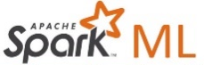








Use what you want
19
Use any framework or library
Use your favorite IDE
Leverage all types of platforms and tools/libraries
Use any tool
Use the most popular innovations
Notes:
Any data, any framework. Tensorflow logo, CNTK logo, Spark logo
See inset for Tensorflow logo

Slide 20
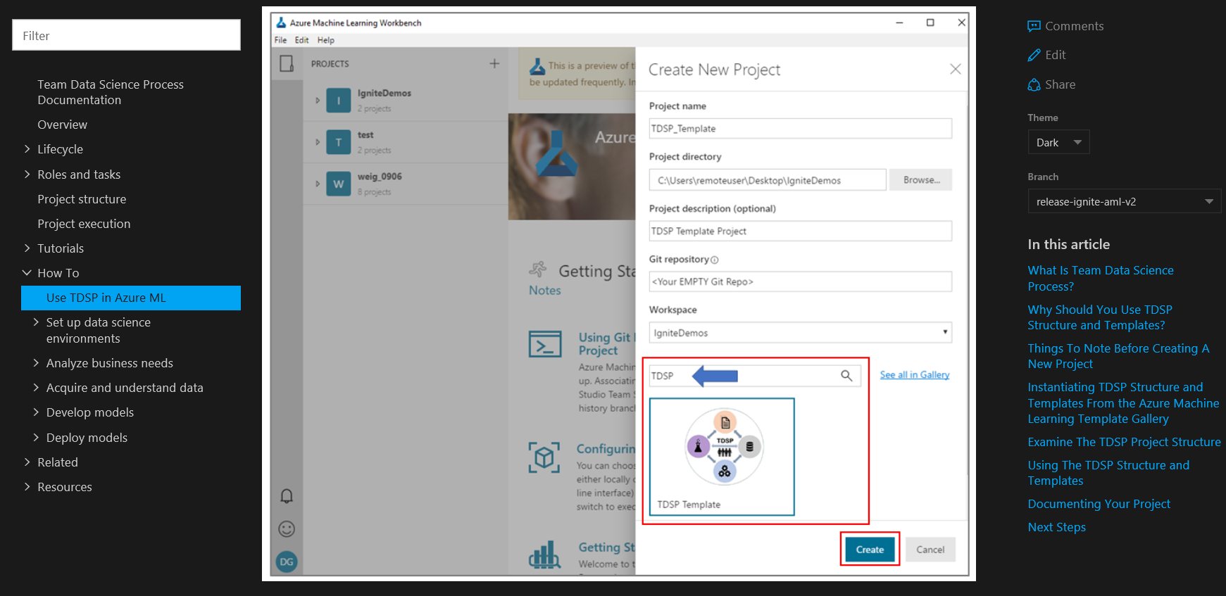

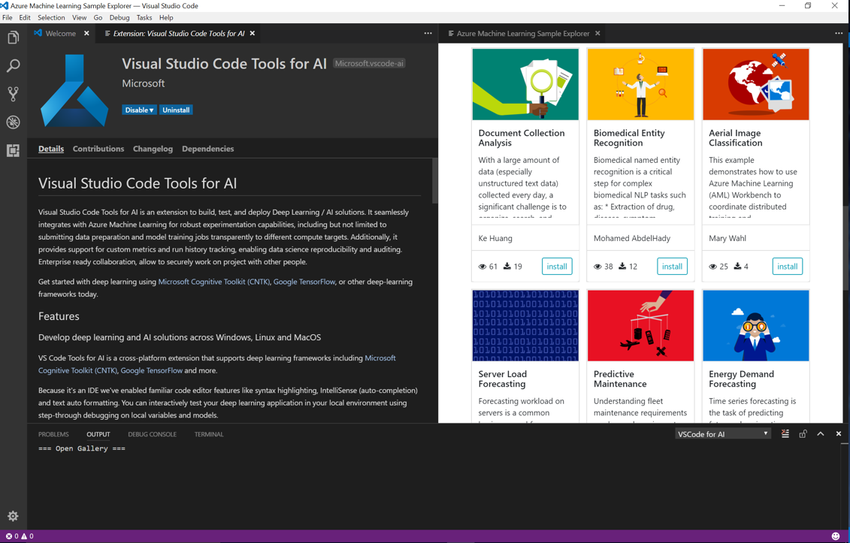
Using TDSP with Azure Machine Learning
20

Slide 21
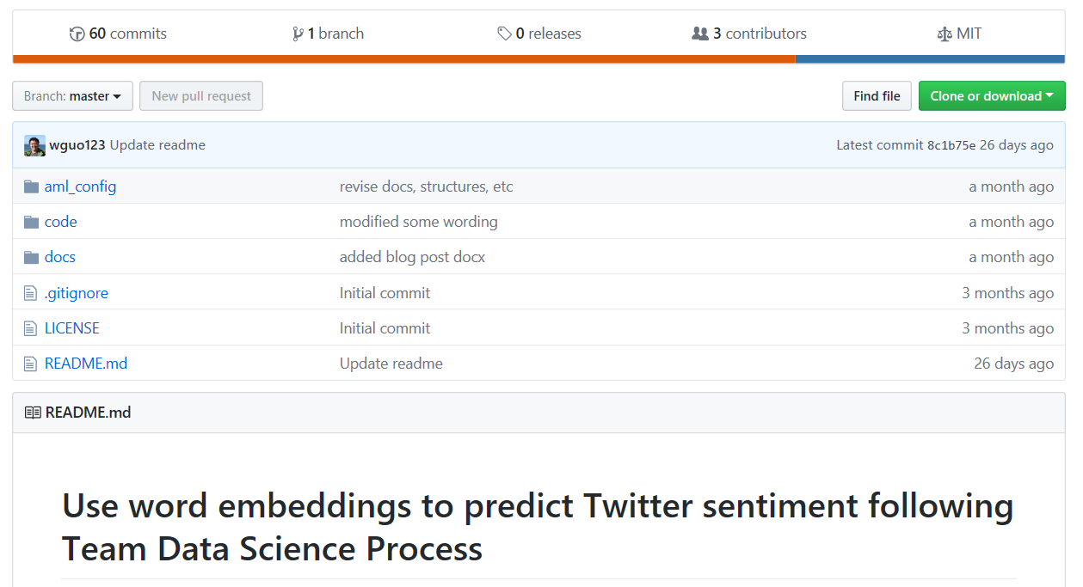
TDSP – AML worked-out samples in AI
21
Unstructured data (NLP) modeling with deep-learning
Sentiment classification using supervised word-embeddings
Biomedical (PubMed) Named entity recognition using LSTM
Structured data
Income classification
Public Github repositories for each sample
https://docs.microsoft.com/en-us/azure/machine-learning/team-data-science-process/walkthroughs

Slide 22
Developing & deploying NLP services on Azure
22

Slide 23
Sentiment classification
23
https://github.com/Azure/MachineLearningSamples-TwitterSentimentPrediction

Slide 24
Use case introduction: Twitter sentiment prediction
24
Predict Twitter sentiment polarity using word embedding and DL for classification
Objective & scientific question
Demonstrate how to develop and deploy sentiment classification service on Azure
Can supervised word embeddings improve accuracy of classification accuracy of sentiment class prediction?
Dataset
“sentiment140”
1.3 million tweets for training
320,000 for testing
Classes - only two, positive and negative (neutral tweets were removed for this exercise)

Slide 25
Analysis strategy
25
Train word embeddings in 2 different ways
Unsupervised: Word2Vec
Supervised: Using CNN to generate classification based embeddings
Train classifier
Evaluate accuracy on test set
Word2Vec
[Unsupervised]
Logistic regression
(Keras + CNTK)
Preprocess tweets
Evaluate accuracy
Gradient boosting trees
Train embedding using tweet classes – CNN (Keras + CNTK)
[Supervised]
Preprocess
Train word vectors
Train tweet classifier
Evaluate

Slide 26
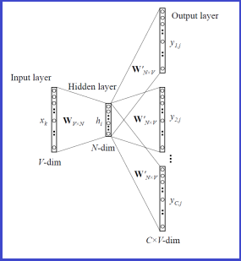
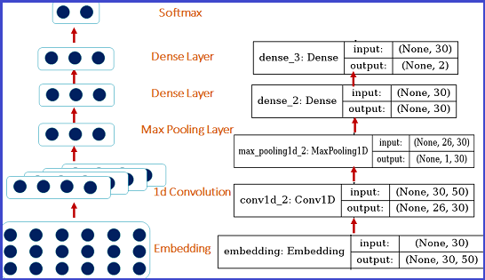
Word embedding generation
26
Word2Vec: skip-gram
Supervised word embeddings using CNN

Slide 27
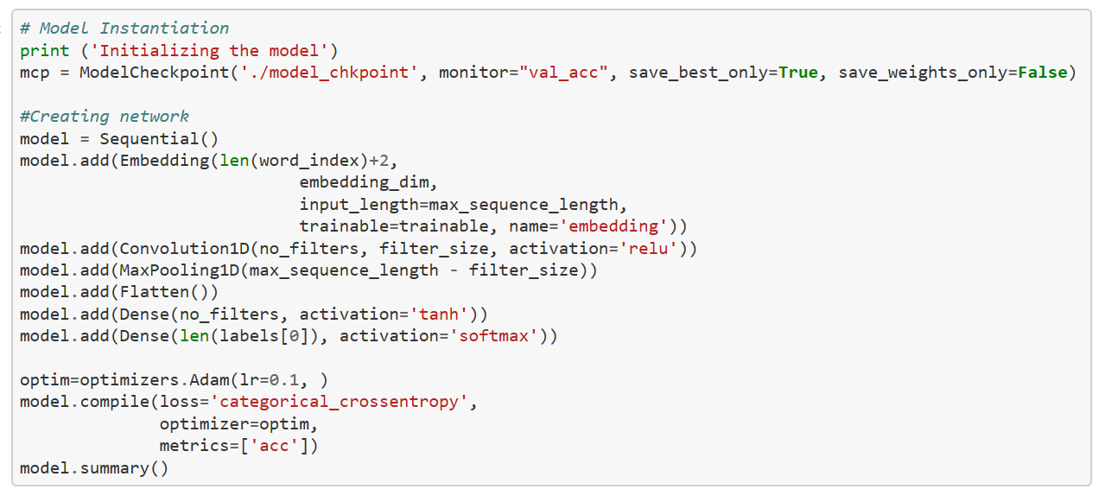
Supervised embedding generation using CNN
27
code

Slide 28
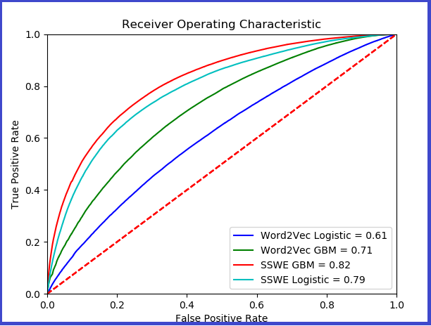
Model evaluation: Sentiment-specific word embeddings (SSWE) improves classification of sentiments
28
https://docs.microsoft.com/en-us/azure/machine-learning/team-data-science-process/predict-twitter-sentiment
http://www.aclweb.org/anthology/P14-1146

Slide 29
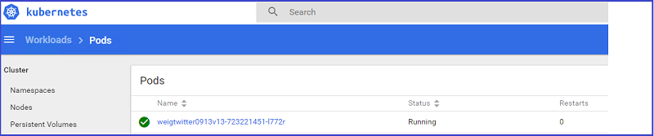
Model deployment
29
The operationalization environment provisions Docker and Kubernetes in the cluster to manage the web-service deployment
az ml service create realtime --model-file (model file name) -f (scoring script name) -n (your-new-acctname) -s (web service schema json file) -r (compute environment, python or PySpark, etc) -d (dependency files)

Slide 30
Named entity recognition (NER)
30
https://github.com/Azure/MachineLearningSamples-BiomedicalEntityExtraction

Slide 31
Use case introduction: Biomedical named entity recognition using LSTMs
31
Identify entities drugs, chemicals & diseases from medical abstracts (PubMed) or medical documents such as electronic health records (EHRs)
Objective & question
Train a scalable model for NER using word vectors and DL architecture
Can we improve NER identification accuracy using domain-specific (biomedical) datasets for word embedding, rather than a generic dataset (e.g. Google news articles)?
Datasets
Word embeddings: Entire set of PubMed abstracts, ~30 MIL
Drugs and disease labeled data-set
Biological entities (protein, DNA, RNA etc.)

Slide 32
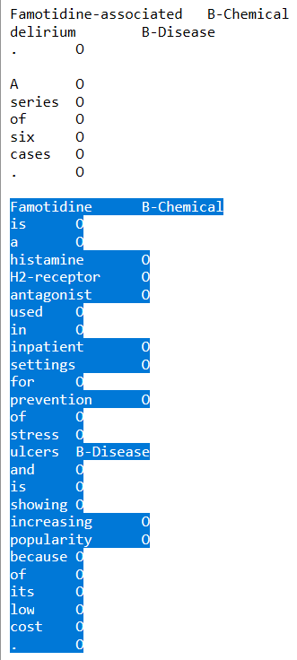
Labeled entity data-sets
32
Training: Typically labeled data containing
500-2,000 abstracts
8,000-20,000 sentences
Test: Typically labeled data
200-400 abstracts
600-4,000 sentences

Slide 33
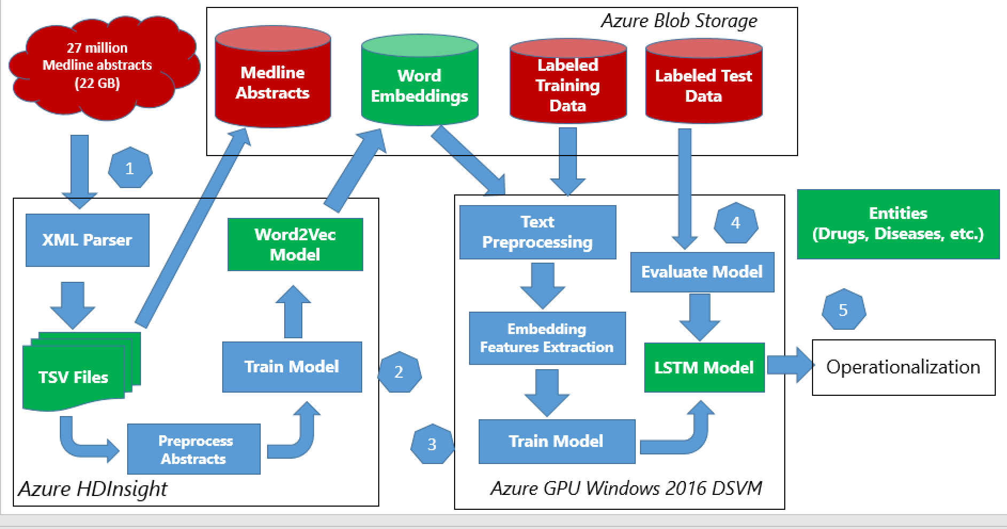
Architecture: Data pipeline and experimental setup
33

Slide 34
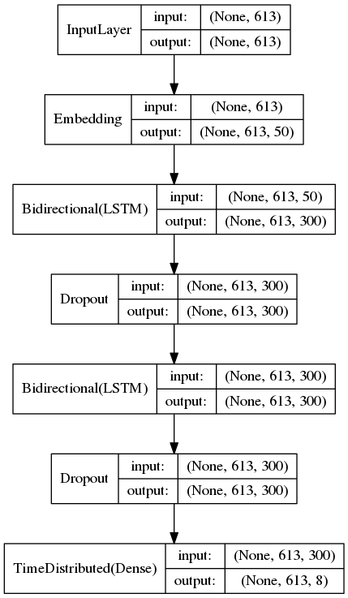
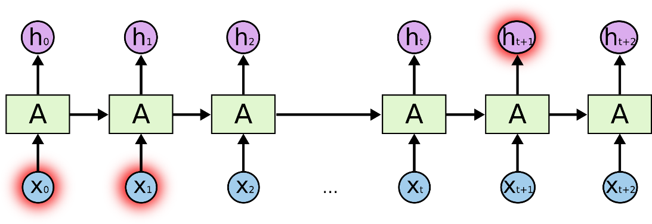
Word2Vec & Bi-directional LSTM model architecture
34
Bi-directional LSTM for NER
Word2Vec training:
Spark MLlib implementation
Azure HDInsight Spark cluster
11 nodes
LSTM training:
GPU – DSVM (data science VM)
RNN
LSTM - Long Short Term Memory networks - special kind of RNN, capable of learning long-term dependencies (details not shown)
http://colah.github.io/posts/2015-08-Understanding-LSTMs/

Slide 35
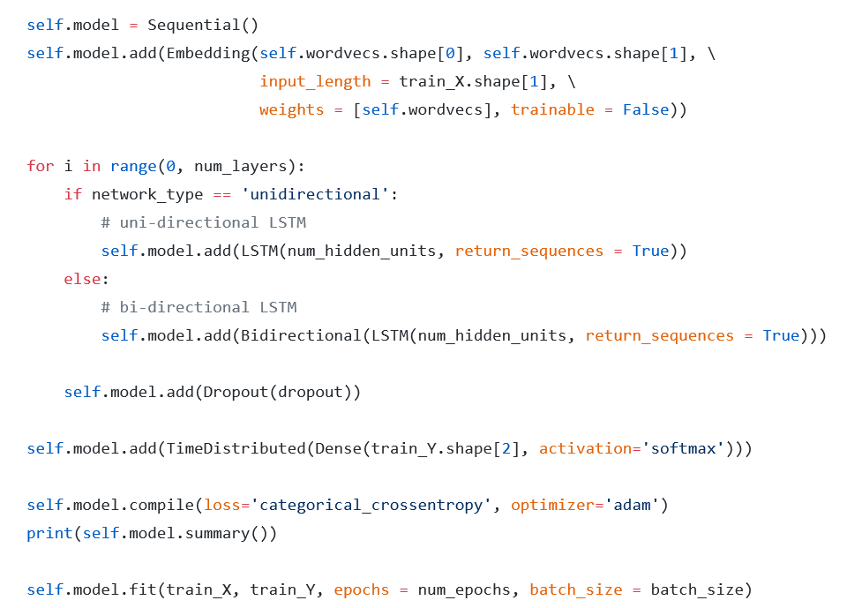
Bi-directional LSTM for NER - code
35

Slide 36
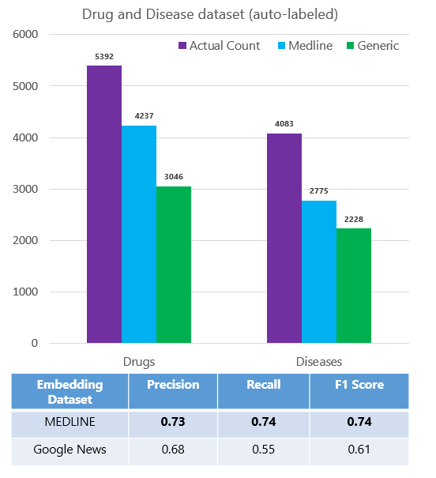
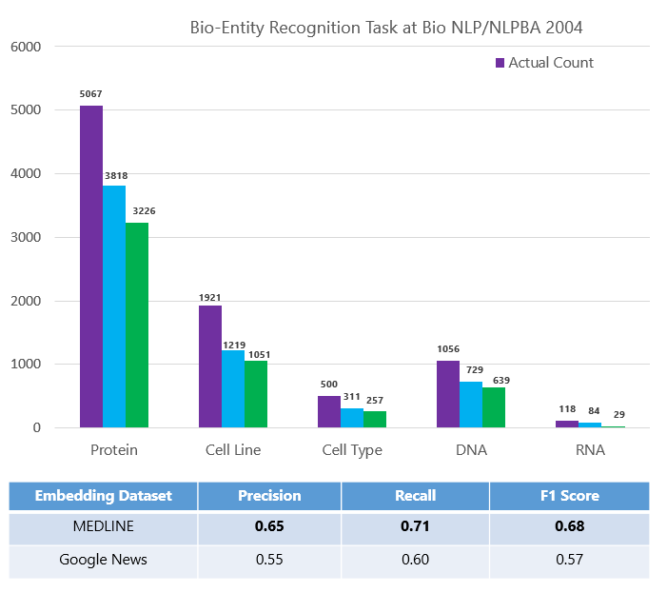
Biomedical NER model evaluation Doman-specific embedding improve performance of NER identification
36
Semeval 2013 - Task 9.1 (Drug Recognition)
BioCreative V CDR task

Slide 37
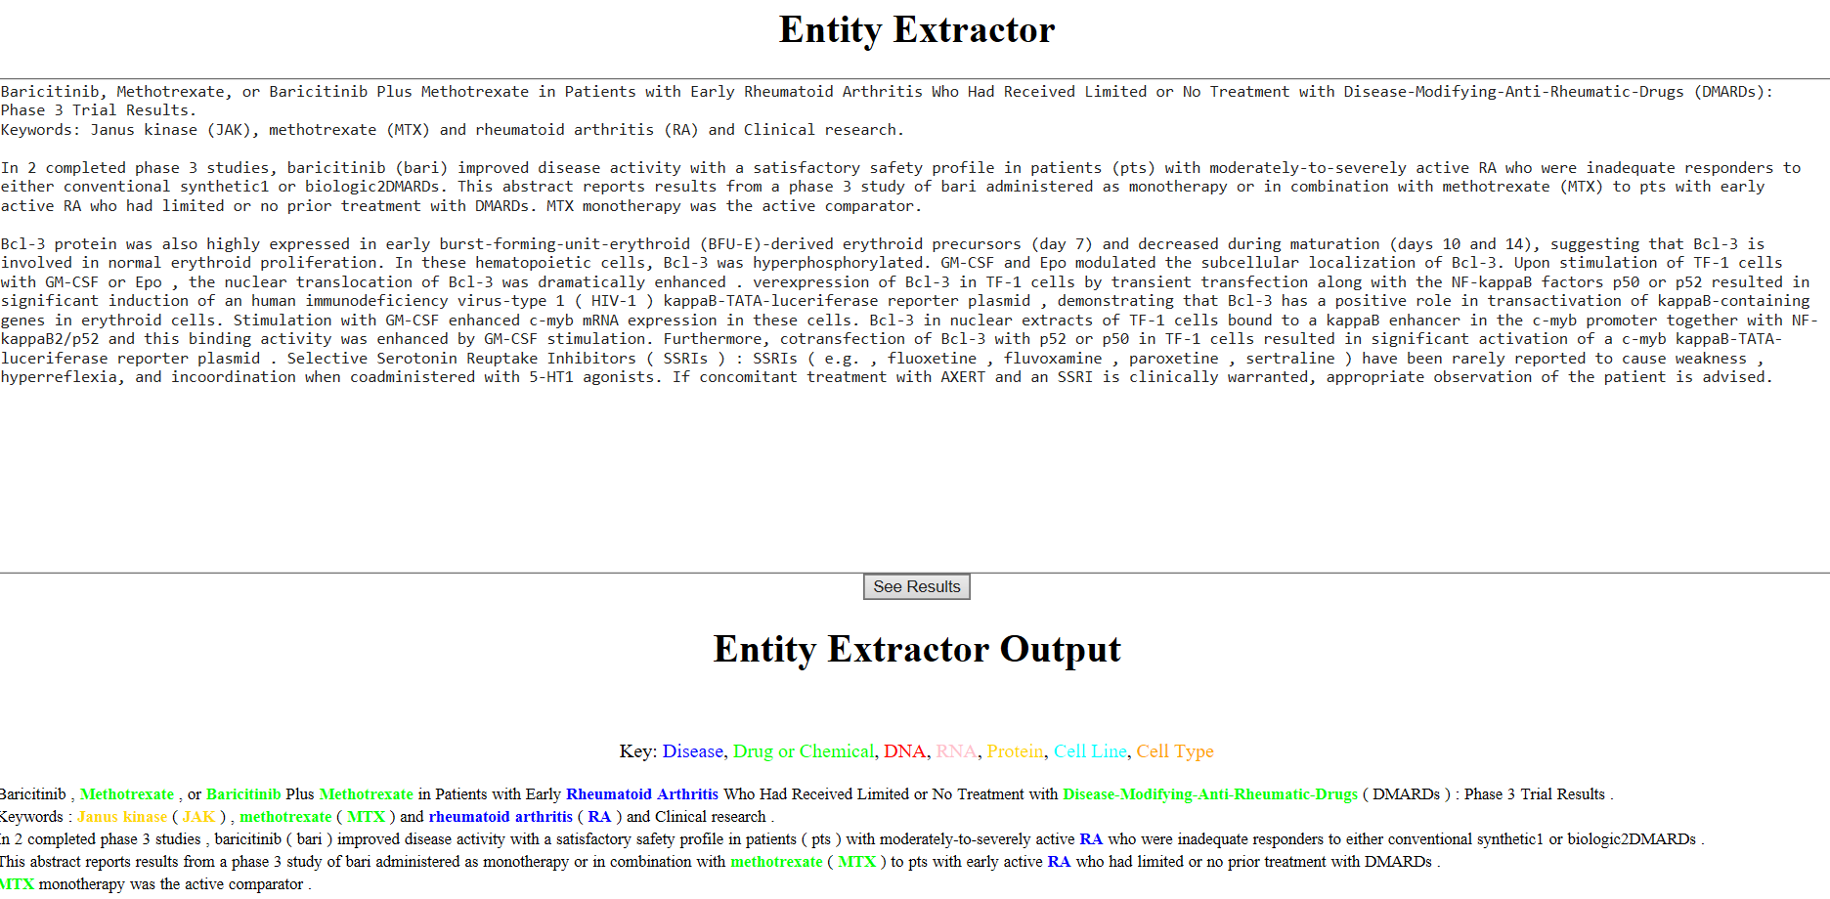
Detection of entities – example with biomedical abstract from PubMed

Slide 38
Summary
38
TDSP (Team Data Science Process) provides a standardized data science process for development & deployment of AI services on Azure
Resources are available to use TDSP and AML together, along with other data platforms on Azure to develop and deploy AI solutions
Common DL use cases are provided as examples in open GitHub repos, with suggestions and experiments on how to improve performance

Slide 39
Thank you!
39
https://aka.ms/tdsp
tdsp@microsoft.com
Deck available @: https://aka.ms/tdsp-presentations

